Slide 1
Natural Language Generation
Tianwei She
11-08-2018

Slide 2
Agenda
Natural Language Generation (NLG) / Data-to-text generation
Modular approaches & Encoder-decoder models
Paper 1: What to talk about and how? Selective Generation using LSTMs with Coarse-to-Fine Alignment
Evaluations
Paper 2: An Investigation into the Validity of Some Metrics for Automatically Evaluating Natural Language Generation Systems
STOA developments
Paper 3: Challenges in Data-to-Document Generation
Paper 4: Data-to-Text Generation with Content Selection and Planning
Discussion

Slide 3
Natural language generation
Text Generation
Poems
Fake papers
Stories
...
Text-to-text generation
Machine translation
Summarization
…...
Data-to-text generation
Soccer reports
News report on current affairs
Financial reports
Image captioning
…...
Gatt, A., & Krahmer, E. (2018). Survey of the State of the Art in Natural Language Generation: Core tasks, applications and evaluation. Journal of Artificial Intelligence Research, 61, 65-170.
Notes:
Text generation: generating texts from language model, which doesn’t depend on explicit input
Text-to-text: take existing texts as their input, and automatically produce a new, coherent text as output.
Data-to-text: automatically generate text from non-linguistic data

Slide 4
Natural language generation is characterized as ...
“The subﬁeld of artiﬁcial intelligence and computational linguistics that is concerned with the construction of computer systems that can produce understandable texts in English or other human languages from some underlying non-linguistic representation of information”
Reiter, E., & Dale, R. (1997). Building applied natural language generation systems. Natural Language Engineering, 3(1), 57-87.
Notes:
The term ‘Natural Language Generation’ is used to refer to systems that generate text from non-linguistic data.
Today, I’ll use “NLG” and “data-to-text” generation interchangeably.

Slide 5
NLG systems - FOG (Goldberg et al., 1994)
The FOG system generates textual weather forecasts from numerical weather simulations for Environment Canada (the Canadian Weather Service).
It can produce forecast texts in both English and French. It has been in everyday use since 1993.
Reiter, E., & Dale, R. (1997). Building applied natural language generation systems. Natural Language Engineering, 3(1), 57-87.
Notes:
One of the earliest NLG system

Slide 6
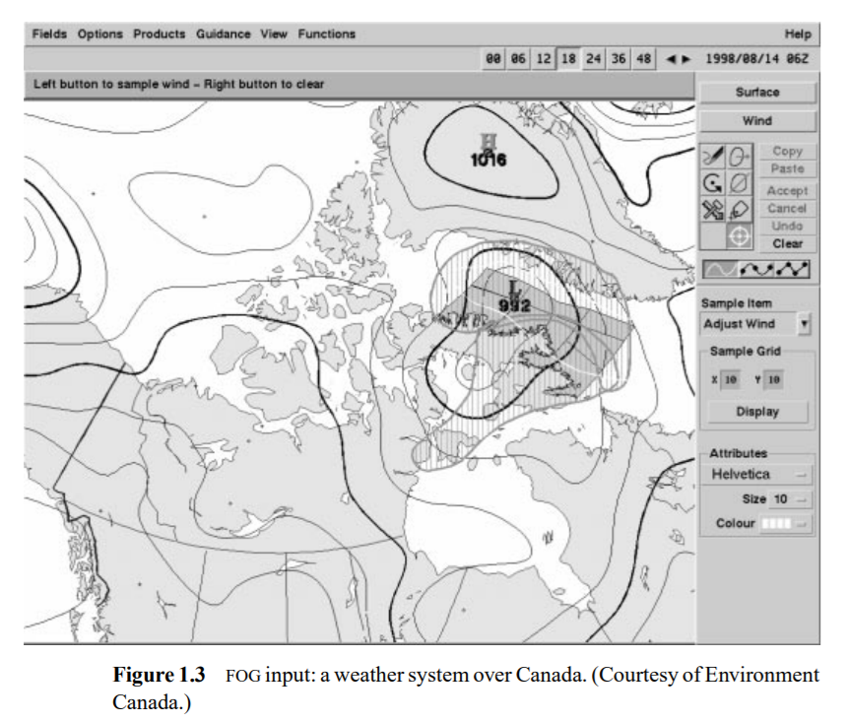
NLG systems - FOG (Goldberg et al., 1994)
Reiter, E., & Dale, R. (1997). Building applied natural language generation systems. Natural Language Engineering, 3(1), 57-87.
Notes:
It takes as input a numerical prediction of weather
It produces as output a textual summary of this information.
The system has been in use since 1993

Slide 7
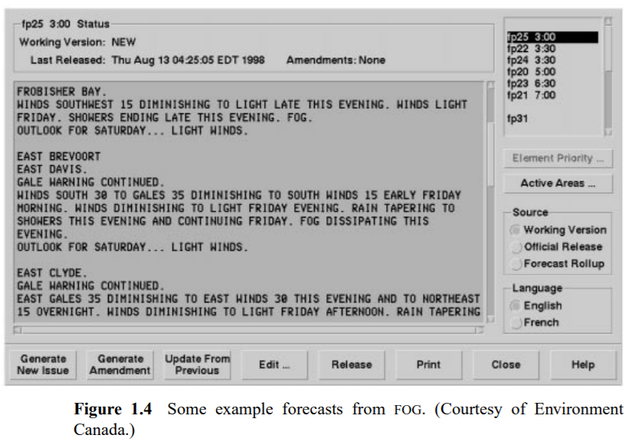
NLG systems - FOG (Goldberg et al., 1994)
Reiter, E., & Dale, R. (1997). Building applied natural language generation systems. Natural Language Engineering, 3(1), 57-87.
Notes:
It takes as input a numerical prediction of weather over a given region in a specified time interval.
It produces as output a textual summary of this information.
The system has been in use since 1993

Slide 8
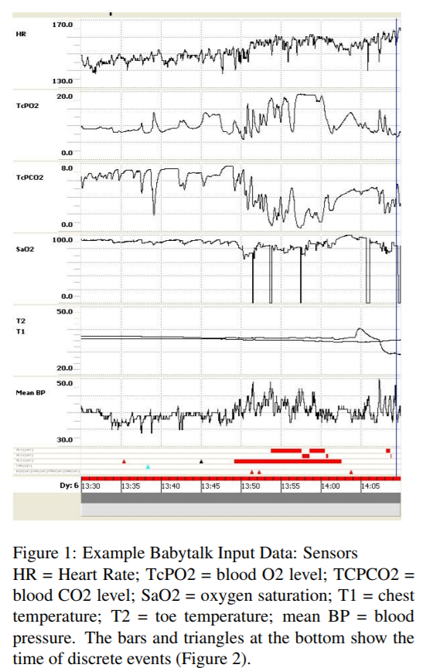
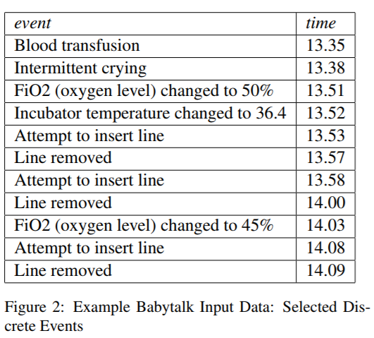
NLG systems - BABYTALK (Reiter et al., 2008)
The system generates textual summaries of clinical data about babies.
Reiter, E., Gatt, A., Portet, F., & Van Der Meulen, M. (2008, June). The importance of narrative and other lessons from an evaluation of an NLG system that summarises clinical data. In Proceedings of the Fifth International Natural Language Generation Conference (pp. 147-156). Association for Computational Linguistics.

Slide 9
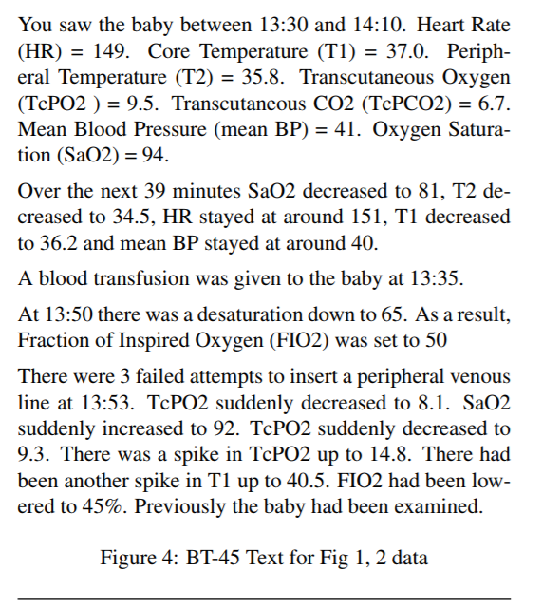
NLG systems - BABYTALK (Reiter et al., 2008)
Reiter, E., Gatt, A., Portet, F., & Van Der Meulen, M. (2008, June). The importance of narrative and other lessons from an evaluation of an NLG system that summarises clinical data. In Proceedings of the Fifth International Natural Language Generation Conference (pp. 147-156). Association for Computational Linguistics.

Slide 10
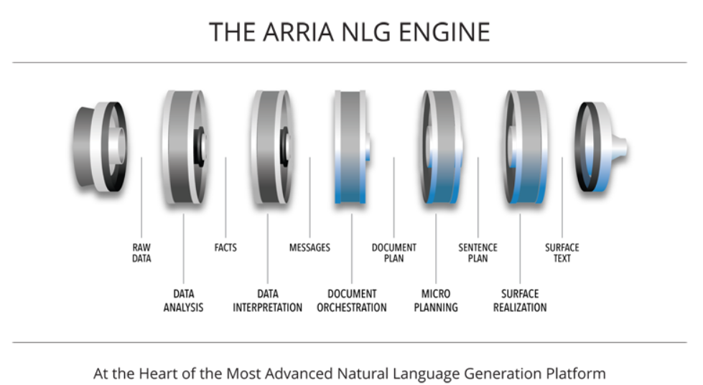
NLG systems - ARRIA
https://www.arria.com/about/about-overview/
Notes:
Provides NLG solutions for industries
The core architecture of their platform is the algorithms that we’ll cover today.

Slide 11
Data-to-text generation
A small number of structured data records, such as a table
Text that can
adequately and fluently describes the data
Notes:
Those are some examples of NLG systems or applications.
Here’s a more explicit definition of it as a research problem.
“Adequate” and “fluent” are two main objective. Talk about it in detail later in evaluations part.

Slide 12
Benchmark datasets
WEATHERGOV, 2008
ROBOCUP, 2009
WIKIBIO, 2016
ROTOWIRE and SBNATION, 2017

Slide 13
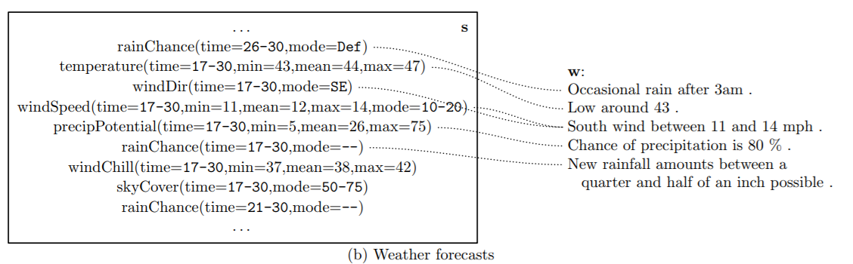
Benchmark datasets
Liang, P., Jordan, M. I., & Klein, D. (2009). Learning Semantic Correspondences with Less Supervision. ACL-IJCNLP 2009, 91.
Notes:
contains information about weather forecast and the text is a short forecast report

Slide 14
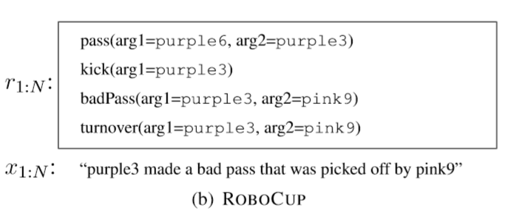
Benchmark datasets
WEATHERGOV, 2008
ROBOCUP, 2009
Robotic soccer events with human commentary for the championship games of Robocup simulation league
WIKIBIO, 2016
ROTOWIRE and SBNATION, 2017
Chen, D. L., & Mooney, R. J. (2008, July). Learning to sportscast: a test of grounded language acquisition. In Proceedings of the 25th international conference on Machine learning (pp. 128-135). ACM.
Notes:
The data involves actions with the ball, such as kicking and passing
The first 2 datasets use relatively simple language and record structure. The datasets are small.

Slide 15
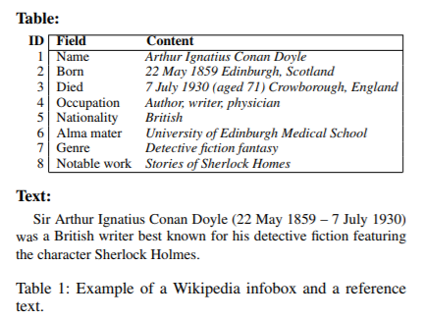
Benchmark datasets
WEATHERGOV, 2008
ROBOCUP, 2009
WIKIBIO, 2016
Biographies from Wikipedia
ROTOWIRE and SBNATION, 2017
Sha, L., Mou, L., Liu, T., Poupart, P., Li, S., Chang, B., & Sui, Z. (2017). Order-planning neural text generation from structured data. arXiv preprint arXiv:1709.00155.
Notes:
the first paragraph (text), the infobox (structured data)
https://github.com/DavidGrangier/wikipedia-biography-dataset

Slide 16
Benchmark datasets
WEATHERGOV, 2008
ROBOCUP, 2009
WIKIBIO, 2016
ROTOWIRE and SBNATION, 2017
Articles summarizing NBA basketball games with corresponding box- and line-score tables
Sha, L., Mou, L., Liu, T., Poupart, P., Li, S., Chang, B., & Sui, Z. (2017). Order-planning neural text generation from structured data. arXiv preprint arXiv:1709.00155.

Slide 17
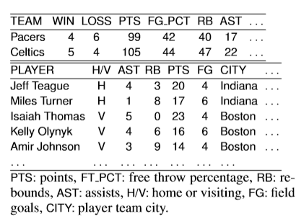
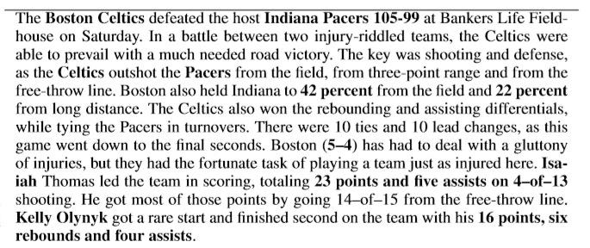
Benchmark datasets
Puduppully, R., Dong, L., & Lapata, M. (2018). Data-to-Text Generation with Content Selection and Planning. arXiv preprint arXiv:1809.00582.
Notes:
articles summarizing NBA basketball games + corresponding box- and line-score tables
https://github.com/harvardnlp/boxscore-data

Slide 18
NLG tasks
Content determination
Text structuring
Sentence aggregation
Linguistic realization
Referring expression generation
Lexicalization
Gatt, A., & Krahmer, E. (2018). Survey of the State of the Art in Natural Language Generation: Core tasks, applications and evaluation. Journal of Artificial Intelligence Research, 61, 65-170.

Slide 19
NLG tasks
Content selection: to decide which information should be included in the text under construction, and which should not.
Text structuring: to decide the order of presentation to the reader
Sentence aggregation: to combine multiple messages into a single sentence
Lexicalization: to find the right words and phrases to express information
Referring expression generation: to decide whether entities are referred to using a pronoun, a proper name or an definite description
Linguistic realization: to form a well-formed sentence by ordering constituents of a sentence, as well as generating the right morphological forms

Slide 20
NLG modular approaches
Text Planner
Sentence Planner
Content determination
Text structuring
Sentence aggregation
Realizer
Linguistic realization
Referring expression generation
Lexicalization
Gatt, A., & Krahmer, E. (2018). Survey of the State of the Art in Natural Language Generation: Core tasks, applications and evaluation. Journal of Artificial Intelligence Research, 61, 65-170.
Notes:
‘Consensus’ pipeline architecture

Slide 21
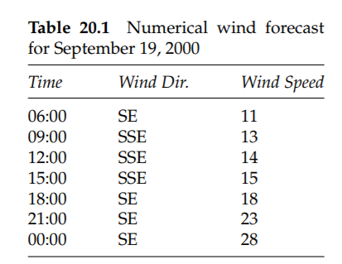
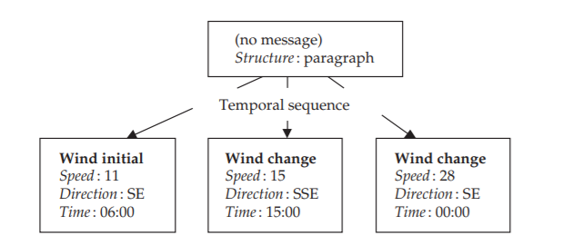
Text planner
Notes:
It decides what information to communicate in the text and how this information should be organized.

Slide 22
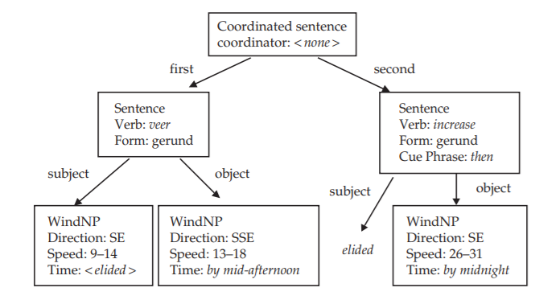
Sentence planner
Notes:
It decides how information is linguistically expressed in the generated text

Slide 23
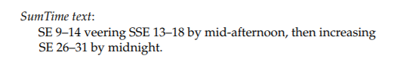
Realizer
Notes:
The realizer generates an actual text based on the information selected by the text planning module and the linguistic choices made by the sentence planner

Slide 24
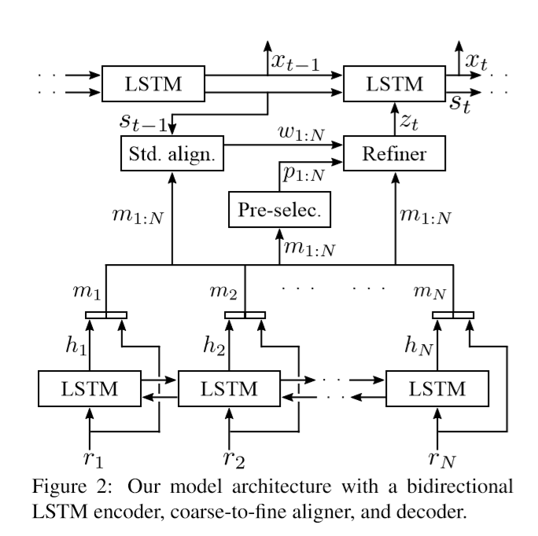
Encoder-decoder architecture
Mei, H., Bansal, M., & Walter, M. R. (2015). What to talk about and how? selective generation using lstms with coarse-to-fine alignment. arXiv preprint arXiv:1509.00838.

Slide 25
What to talk about and how?
Selective Generation using LSTMs with Coarse-to-Fine Alignment
Hongyuan Mei, Mohit Bansal, Matthew R. Walter
NAACL 2016
Notes:
1st work in this field using neural method

Slide 26
Contributions
They proposed an end-to-end, domain independent neural encoder-aligner-decoder model for selective generation.
They utilized a novel coarse-to-ﬁne aligner to identify the small subset of salient records to talk about.
The model achieves the best selection and generation results reported to-date (with 59% relative improvement in generation) on the benchmark WEATHERGOV dataset.

Slide 27
Encoder-Aligner-Decoder
Notes:
The model ﬁrst encodes each input record rj into a hidden state hj using a bidirectional LSTM. And then they use an aligner acts on the mj, which is the concatenation of each record and its hidden state. The aligner acts on m_{j} to compute the selection decision zt at each decoding step t. The model then employs a LSTM decoder to generate the output.
Embedding: self-trained and pre-trained (word2vec)

Slide 28
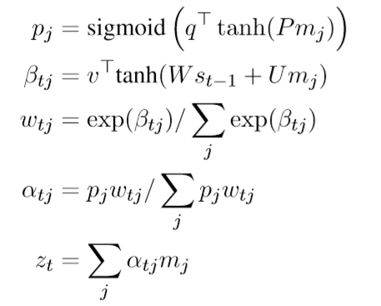
Coarse-to-fine Aligner
Notes:
The pre-selector ﬁrst assigns a probability pj of being selected to each record (1st equation)
The standard aligner computes the alignment likelihood wtj over all the records at each time step t during decoding. (2nd, 3rd equations)
the reﬁner produces the ﬁnal selection decision by re-weighting the aligner weights wtj with the pre-selector probabilities pj (4th, 5th equations)

Slide 29
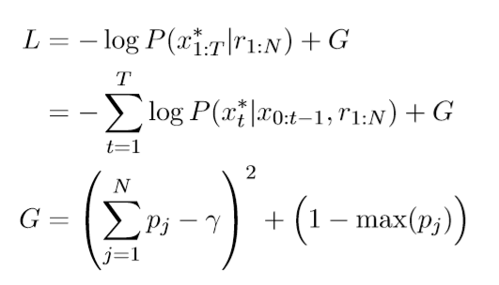
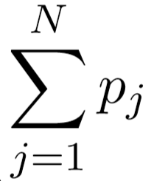
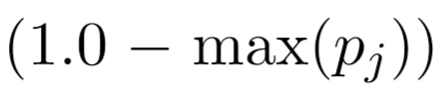
Loss function
Number of selected records
At least 1 record should be pre-selected
Notes:
The loss function is the negative loglikelihood of the ground-truth description plus 2 regularization term.
pj expresses the extent to which the j-th record should be selected. The summation of P can then be regarded as a real-valued approximation to the total number of pre-selected records (denoted as γ),

Slide 30
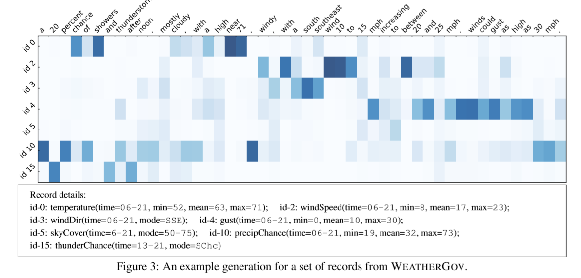
Results
Notes:
The picture shows an example result of this model. The bottom is record set. The output description is in the red box. and record word alignment heat map. As shown, the model learns to align records with their corresponding words.

Slide 31
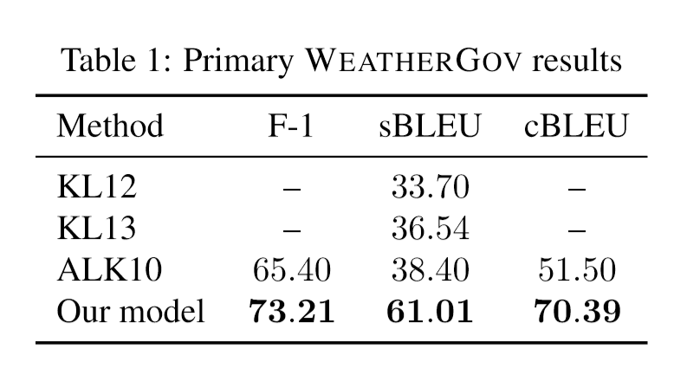
Results on WeatherGov dataset
Very promising improvement over traditional methods!
Content selection performance
Surface realization quality
Notes:
They report the performance of content selection (F-1) and surface realization(BLEU)
The dataset contains gold alignment.
We deﬁne the set of selected records as consisting of the record with the largest selection weight αti computed by our aligner at each decoding step t.
Using seq2seq model shows very promising improvement, especially in surface realization

Slide 32
NLG evaluations
Human evaluations
Fluency or readability: the linguistic quality of the text
Accuracy, adequacy, relevance or correctness relative to the input: the system’s rendition of the content
Automatic corpus-based measures
N-gram overlap
BLEU, NIST, ROUGE, METEOR
Perplexity, STSim
String distance
Content overlap
Gatt, A., & Krahmer, E. (2018). Survey of the State of the Art in Natural Language Generation: Core tasks, applications and evaluation. Journal of Artificial Intelligence Research, 61, 65-170.
Notes:
Generally, the evaluation for NLG systems combines both human rating and automatic metrics

Slide 33
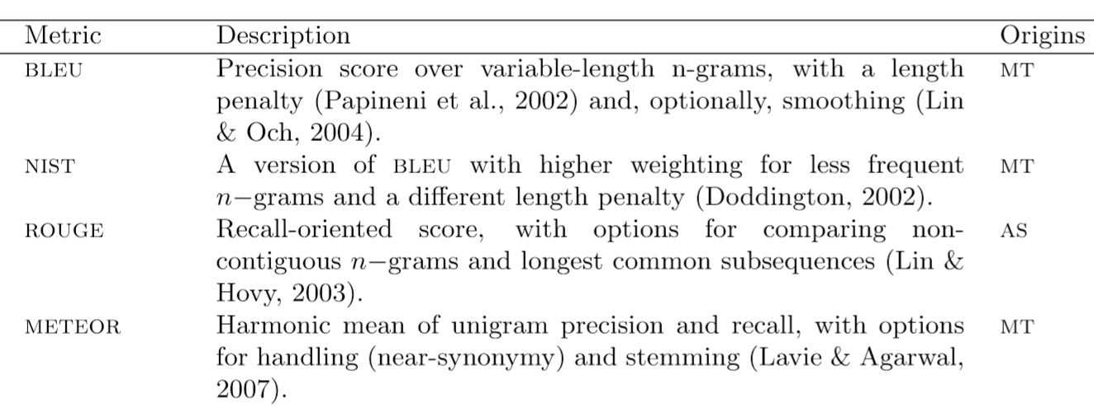
Automatic corpus-based metrics (n-gram overlap)
Gatt, A., & Krahmer, E. (2018). Survey of the State of the Art in Natural Language Generation: Core tasks, applications and evaluation. Journal of Artificial Intelligence Research, 61, 65-170.
Notes:
in real life, sentences can be translated in many different ways, sometimes with no overlap.

Slide 34
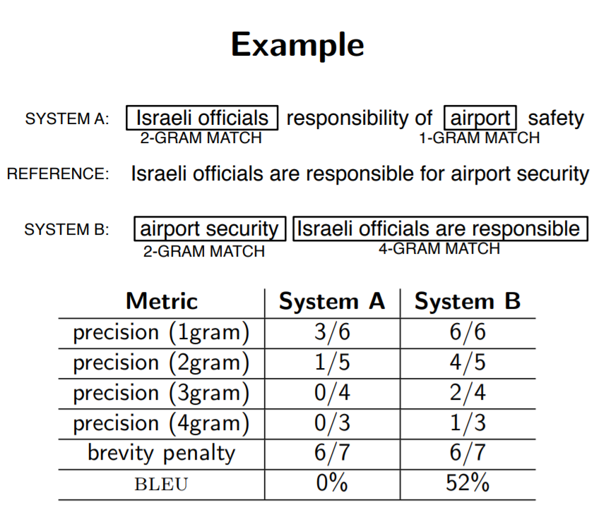
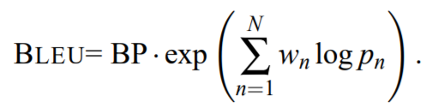
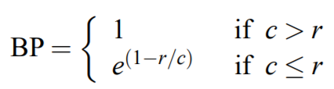
http://www.statmt.org/book/slides/08-evaluation.pdf

Slide 35
Automatic corpus-based metrics
Cheap
Quick
Repeatable
Not require domain expert
The corpus and reference texts are often not of high enough quality
The automatic metrics will not be able to evaluate many important linguistic properties such as information structure
BLEU-like metrics work best with several reference texts for one input
Reiter, E., & Belz, A. (2009). An investigation into the validity of some metrics for automatically evaluating natural language generation systems. Computational Linguistics, 35(4), 529-558.
Notes:
Automatic corpus-based evaluations are appealing in NLG, as in other areas of NLP, because they are relatively cheap and quick to do if a corpus is available, do not require support from domain experts, and are repeatable.
But they have some intrinsic problem as well.

Slide 36
An Investigation into the Validity of Some Metrics for Automatically Evaluating Natural Language Generation Systems
Ehud Reiter, Anja Belz
ACL 2009
Notes:
In order to determine how well the automatic metrics predicted the results of human judgments in the domain of NLG

Slide 37
Experiment
They evaluated a number of systems with the same input/output functionality using different evaluation techniques (human ratings & automatic metrics), and then analyzed the correlation between the techniques.
Systems: SUMTIME system, pCRU generator, Template generator, corpus
Human rating experiments: evaluators were asked to give separate ratings on “clarity and readability” (which was intended to elicit an assessment of linguistic quality) and “accuracy and appropriateness” (which was intended to elicit an assessment of content quality).
Notes:
In this experiment, we care more about the correlation between different evaluation rather than the absolute performances of each algorithm. So I’ll not talk about the detail of the algorithms.

Slide 38
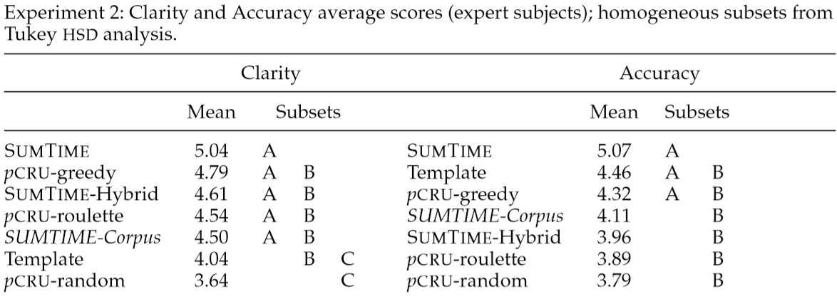
Human ratings
Clarity & Readability - Linguistic quality (0-6)
Accuracy & Appropriateness - Content quality (0-6)
Reiter, E., & Belz, A. (2009). An investigation into the validity of some metrics for automatically evaluating natural language generation systems. Computational Linguistics, 35(4), 529-558.
Notes:
Subsets: systems which are in the same subset do not have statistically signiﬁcant differences in their mean ratings

Slide 39
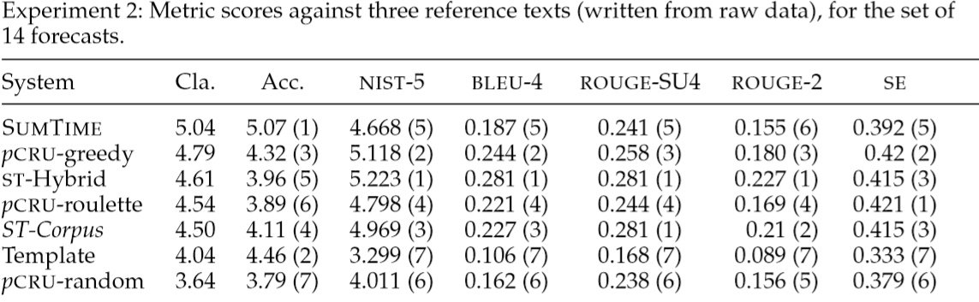
Automatic metrics
Reiter, E., & Belz, A. (2009). An investigation into the validity of some metrics for automatically evaluating natural language generation systems. Computational Linguistics, 35(4), 529-558.
Notes:
They tested ﬁve automatic corpus-based metrics: two variants of the BLEU metric used in machine translation; two variants of the ROUGE metric used in document summarization; and a simple sting-edit distance metric (as a baseline).
The table shows the average scores each metric assigned to each system for the texts used in previous experiment
Cla. = human rating Clarity’
Acc. = human rating Accuracy
(ranking)
The rankings assigned by NIST-5 and BLEU-4 are identical

Slide 40
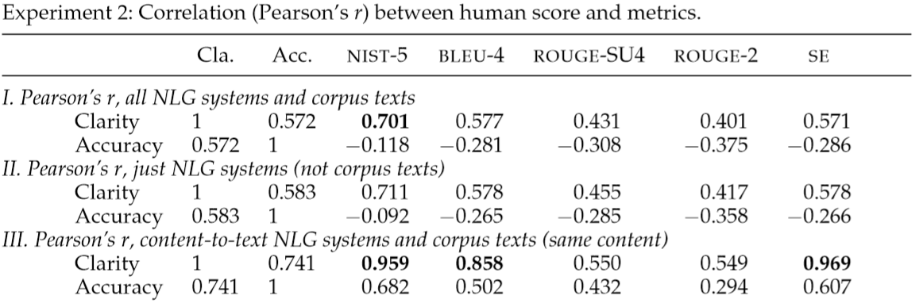
Correlation
NLG systems that generate text from data
NLG systems that generate text from content plain
Corpus
A+B+C
A+B
B+C
Reiter, E., & Belz, A. (2009). An investigation into the validity of some metrics for automatically evaluating natural language generation systems. Computational Linguistics, 35(4), 529-558.
Notes:
A Pearson correlation is a number between -1 and 1 (perfect positive linear) that indicates the extent to which two variables are linearly related.
Clarity is signiﬁcantly correlated with NIST-5 in sets I and III, and BLEU-4 and SE in set III.
Not a single metric correlates signiﬁcantly with human judgments of accuracy

Slide 41
Conclusions about evaluation metrics
BLEU-like metrics do better (higher correlation with human judgments) at estimating linguistic quality. (An investigation into the validity of some metrics for automatically evaluating natural language generation systems)
Metrics such as BLEU are sensitive to the length of the texts under comparison. With shorter texts, n-gram based metrics are likely to result in lower scores. (Survey of the State of the Art in Natural Language Generation)
Multi-reference evaluation metrics are shown to offer significant advantage over single reference-based metrics. (A dataset and evaluation metrics for abstractive compression of sentences and short paragraphs)
Word-overlap metrics fail in capturing the semantic similarity (and other structure) between the model and reference responses. (Towards an Automatic Turing Test: Learning to Evaluate Dialogue Responses)
Notes:
There are some flaws with this experiment (they didn’t do experiments in other domain, the data they rated are small). But it’s in the field of NLG and the experiments are straightforward. And it their conclusions also match with others in some way.
Here I also conclude some findings in other papers that evaluate these automatic metrics in other related domains.

Slide 42
Challenges in Data-to-Document Generation
Sam Wiseman, Stuart M. Shieber, Alexander M. Rush
EMNLP 2017

Slide 43
Contributions
Introduced large-scale corpus which is sufﬁciently large that fully data-driven approaches might be sufﬁcient.
Proposed a series of extractive evaluation models to automatically evaluate output generation performance
Established baselines and studies the strength and weakness of different methods

Slide 44
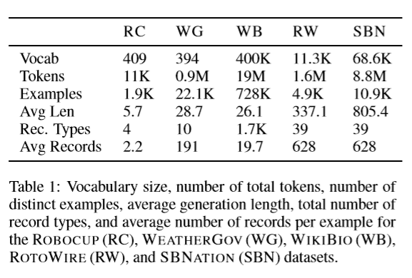
Datasets
Earlier datasets are not sufficient for testing the desired linguistic capabilities of text generation.
Notes:
(Vocabulary size, Average length, record type)ROBOCUP and WEATHERGOV datasets use relatively simple language and record structure.
Although WOKIBIO shows an order of magnitude larger in terms of number of tokens and record types, this dataset only contains short (single-sentence) generations, and relatively few records per generation.
They believe that success on these datasets is not yet sufﬁcient for testing the desired linguistic capabilities of text generation at a document-scale.
The new dataset is intended to be comparable to WEATHERGOV in terms of token count, but to have signiﬁcantly longer target texts, a larger vocabulary space, and to require more difﬁcult content selection.

Slide 45
ROTOWIRE and SBNATION dataset
https://github.com/harvardnlp/boxscore-data
Data
Box score and line score of NBA basketball games
Text
ROTOWIRE: professionally written, medium length game summaries
SBNATION: fan-written summaries targeted at other fans

Slide 46
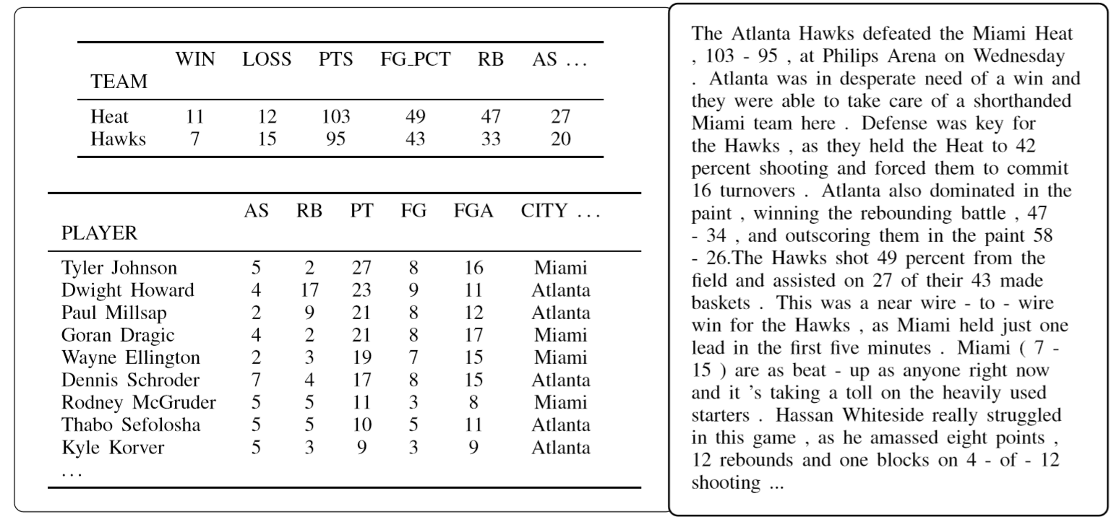

Slide 47
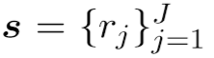
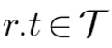
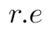
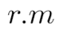
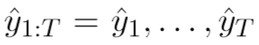
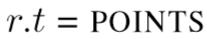
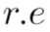
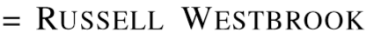
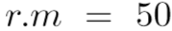
Some notations
A set of records
Record type
Record’s entity
Record’s value
Generated summary of s

Slide 48
Motivation for extractive evaluation
Text generation systems are typically evaluated using a combination of automatic measures, such as BLEU, and human evaluation.
BLEU primarily rewards fluent text generation, rather than generations that capture the most important information in the database, or that report the information in a particularly coherent way.
Human evaluation is much less convenient than using automatic metrics.
Current text generations are sufficiently bad in sufficiently obvious ways that automatic metrics can be of use in evaluation.
Notes:
motivated by some of the shortcomings of current approaches to evaluation.

Slide 49
Extractive evaluations
With a simple, high-precision information extraction model, they proposed 3 induced metrics:
Content selection (CS)
precision and recall of unique relations r extracted from generated summaries that are also extracted from golden summaries.
This measures how well the generated document matches the gold document in terms of selecting which records to generate.
Relation generation (RG)
Content ordering (CO)

Slide 50
Extractive evaluations
With a simple, high-precision information extraction model, they proposed 3 induced metrics:
Content selection (CS)
Relation generation (RG)
precision and number of unique relations r extracted from generated summaries that also appear in s.
This measures how well the system is able to generate text containing factual (i.e., correct) records.
Content ordering (CO)

Slide 51
Extractive evaluations
With a simple, high-precision information extraction model, they proposed 3 induced metrics:
Content selection (CS)
Relation generation (RG)
Content ordering (CO)
Normalized Damerau-Levenshtein Distance between the sequences of records extracted from golden summaries and that extracted from generated summaries.
This measures how well the system orders the records it chooses to discuss.

Slide 52
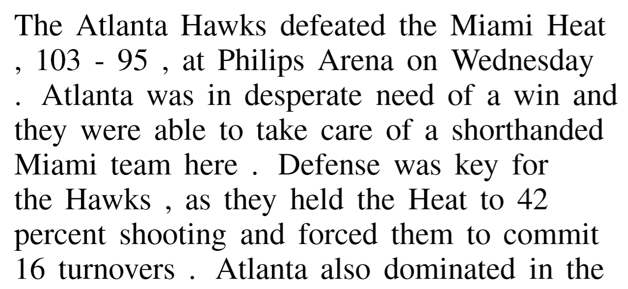
How the extraction system works?
During evaluation,
Extract (r.e, r.m) pairs
Predict its r.t with a trained model
Notes:
MIAMI HEAT, 95, POINTS
ensembling 3 convolutional models and 3 bidirectional LSTM
In the code so I’ll not explain it in detail here

Slide 53
Neural models
Base model
Embedding + 1-layer LSTM encoder + Attention + 2-layer LSTM decoder
Templated generator:
1 sentence about the teams playing in the game
6 highest-scoring players in the game
a typical end sentence
Joint copy, conditioned copy
Reconstruction losses
Total variation distance (TVD)
https://github.com/harvardnlp/data2text

Slide 54
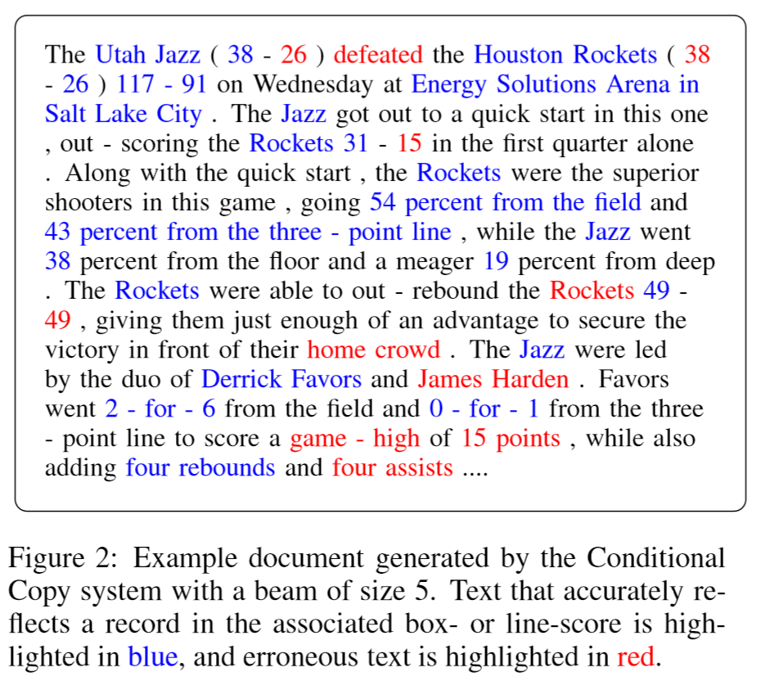
Results

Slide 55
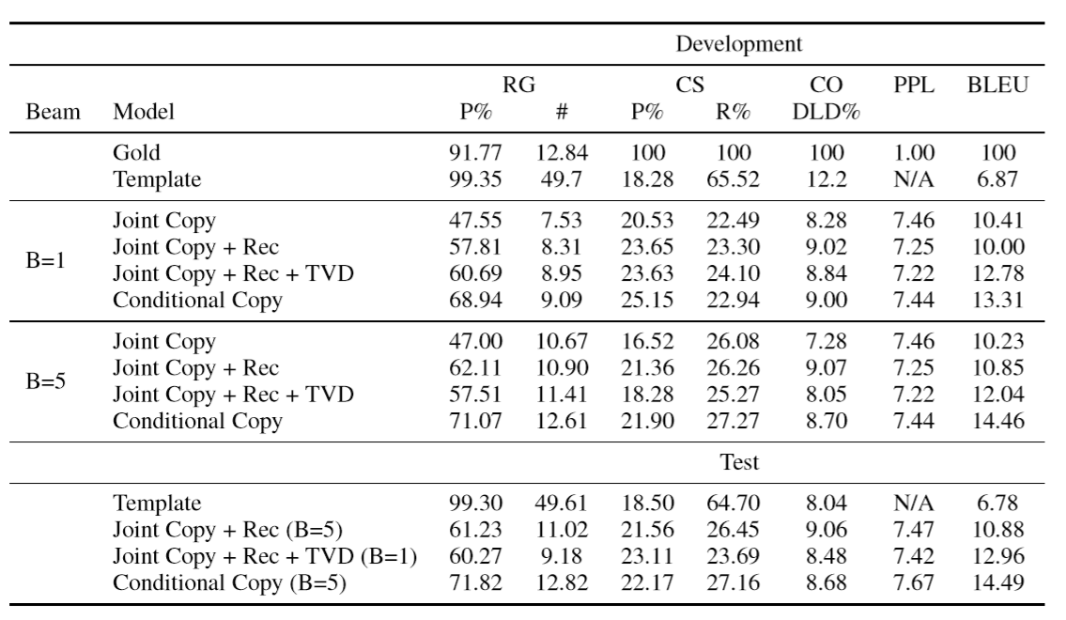
Results
Template models scores very poorly on BLEU, but does quite well on the extractive metrics

Slide 56
Results
All the neural models make significant improvement in terms of BLEU score

Slide 57
Results
On the gold documents, the extractive model reaches 92% precision, which shows the effectiveness of extractive model.

Slide 58
Results
Conditional copy can significantly improve RG, indicating that relationships are generated more accurately. And this is potentially the cause of improved BLEU score

Slide 59
Results
Content selection (CS) and content ordering (CO) seem to have no correlation at all with BLEU.

Slide 60
Results
Template models scores very poorly on BLEU, but does quite well on the extractive metrics
All the neural models make significant improvement in terms of BLEU score
On the gold documents, the extractive model reaches 92% precision, which shows the effectiveness of extractive model.
Conditional copy can significantly improve RG, indicating that relationships are generated more accurately. And this is potentially the cause of improved BLEU score
Content selection (CS) and content ordering (CO) seem to have no correlation at all with BLEU.

Slide 61
Data-to-Text Generation with Content Selection and Planning
Ratish Puduppully, Li Dong, Mirella Lapata
3 Sep 2018
Notes:
They use the same metrics and same dataset with the 3rd paper.
Their model outperforms strong baselines improving the state-of-the-art.
I’ll focus on the their proposed model.

Slide 62
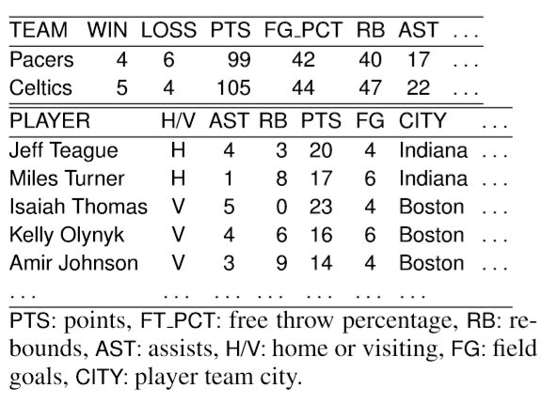
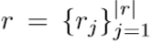
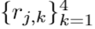
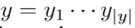
Problem formulation
A table of records
Each record has 4 features
Output document
Content plan

Slide 63
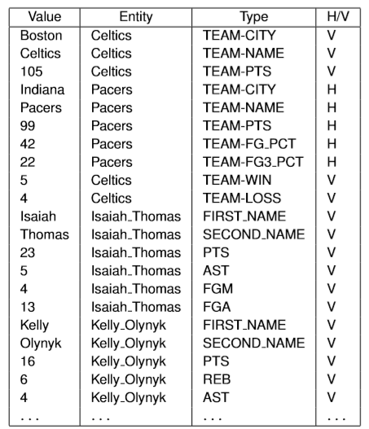
Problem formulation
A table of records
Each record has 4 features
Output document
Content plan
Notes:
Each record rj has four features including its type (rj,1; the column name; e.g., LOSS, CITY), entity (rj,2; the row name; e.g., Pacers, Miles Turner), value (rj,3; the value; e.g., 11, Indiana), and whether a player is on the home- or away-team (rj,4; for joining 2 tables; see column H/V inTable1)

Slide 64
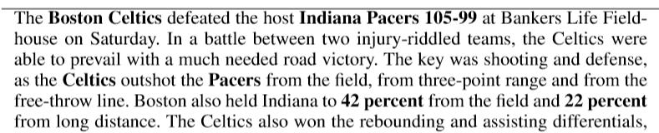
Problem formulation
A table of records
Each record has 4 features
Output document
Content plan

Slide 65
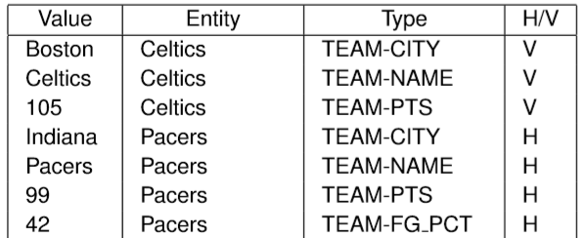
Problem formulation
A table of records
Each record has 4 features
Output document
Content plan
Notes:
Content plan is a subset of the input records in a new order

Slide 66


Framework
Notes:
Content selection: selects information of each record
Content planning: generate a sequence of input records in a desired order
Text decoder produces the output text given the content plan as input

Slide 67

Framework
Notes:
Orange: Content selection gate
Blue: Content planning network

Slide 68




Content selection gate
g_{j}
c_{j}
α_{j,k}
Notes:
Record encoder: orange box; r_{2,1} are 4 embedded features of one record. And then concatenate and encode them into a vector representation of the 2nd record, r₂.
Compute the attention scores αj,k over the input table and use them to obtain an attentional vector ratt j for each record rj:
Gate gj ∈ [0,1]n, Circle denotes element-wise multiplication. So the gate vector controls the amount of information ﬂowing from rj. In other words, each element in rj is weighed by the corresponding element of the content selection gate gj.
New representation of each record

Slide 69

Content planning
One-layer pointer network
Notes:
The ﬁrst hidden state of the decoder is initialized by avg of all record vectors
At decoding step k, we have h_{k} as the hidden state of the LSTM
We model the probability of selecting record j as the kth element of the content plan, p(zk = rj|z<k,r), as the attention over input records
Once z_{k} points to record rj, we use the corresponding vector r^{cs}_{j} as the input of the next LSTM unit in the decoder

Slide 70


Text generation
Notes:
The rcs are output sequence of the content planner we just talked about.
Now we’ll encode the content plan and then decode it as our final output
Green e are encoder and above orange d are decoder
We ﬁrst encode the content plan z into {e_{k}} using a bidirectional LSTM. Because the content plan is a sequence of input records, they directly feed the corresponding record vectors {r_{cs} } as input to this LSTM units.
The text decoder is also based on a recurrent neural network with LSTM units. The decoder is initialized with the hidden states of the ﬁnal step in the encoder. At decoding step t, the input of the LSTM unit is the embedding of the previously predicted word y_{t−1}.
d_{t} is the hidden state of LSTM unit. The probability of predicting y_{t} from the output vocabulary is computed via those equations

Slide 71


Copy mechanism
Joint copy
Conditional copy

Slide 72

Training
Dimension of embedding and LSTM hidden units = 600
Content planning - one-layer pointer networks
Text generation - two-layer LSTM
Dropout rate = 0.3
N_epochs = 25
Adagrad optimizer
Beam_size = 5
Notes:
The model is trained to maximize the log-likelihood of the gold content plan given table records r and the gold output text given the content plan and table records
The “gold” content plan is extracted from the gold output text by a fairly accurate IE system proposed in last paper.

Slide 73

Results

Slide 74

Results - Automatic evaluation
NCP improves upon vanilla encoder-decoder models (ED+JC, ED+CC), irrespective of the copy mechanism being employed.
Overall, NCP+CC achieves best content selection and content ordering scores in terms of BLEU.
Template-system obtains low BLEU and CS precision but scores high on CS recall and RG metrics.
Notes:
This is not surprising as the template system is provided with domain knowledge which our model does not have, and thus represents an upper-bound on content selection and relation generation.

Slide 75

Results - Human-based evaluation
Notes:
Gold summaries were perceived as signiﬁcantly better compared to the automatic systems across all criteria
Grammatically: NCP+CC was perceived as signiﬁcantly more grammatical than WS-2017 but not compared to TEMPL which does not suffer from ﬂuency errors since it does not perform any generation.
Coherence: NCP+CC was perceived as signiﬁcantly more coherent than TEMPL and WS-2017
Conciseness: the neural systems are signiﬁcantly worse than TEMPL, while NCP+CC is signiﬁcantly better than WS-2017.

Slide 76
NLG / Data-to-text generation
We have covered
Task definition and applications
Modular approaches & Seq2seq models
Automatic evaluation & human ratings
Benchmark datasets
SOTA end-to-end models enhanced with two modules architecture

Slide 77
Conclusions for Paper 3 & 4
All the neural models make significant improvement in terms of BLEU score
SOTA model with copying shows some improvement than baseline
However, there is a signiﬁcant gap between automatically generated summaries and human-authored ones.
Future research should focus further on generation problems that are relevant both to content selection and surface realization.

Slide 78
Related readings
Grounded language acquisition (text-data alignment)
Learning to Sportscast: A Test of Grounded Language Acquisition (ICML, 2008)
Learning Semantic Correspondences with Less Supervision (ACL, 2009)
Learning Latent Semantic Annotations for Grounding Natural Language to Structured Data (EMNLP, 2018)
Generating creative text
Neural Text Generation in Stories Using Entity Representations as Context (NAACL, 2018)
Hierarchical Neural Story Generation (ACL, 2018)
A Survey on Intelligent Poetry Generation: Languages, Features, Techniques, Reutilisation and Evaluation (2018)
Beyond Narrative Description: Generating Poetry from Images by Multi-Adversarial Training (ACM Multimedia Best Paper, 2018)
Notes:
Grounded language acquisition is quite related to NLG. 2 old benchmark datasets were proposed in the first 2 paper. The idea can be extended to evaluation of content quality of NLG.

Slide 79
Discussion
In Paper 3, the proposed automatic metrics for evaluating content depend on a trained information extraction model, which is not interpretable and not generalizable to other domains. Do you think this is a reliable metric? Other ideas on content quality evaluation?
Most of the automatic metrics are corpus-based, which fail to capture semantic similarity. Any thoughts on unsupervised metrics for language?
Is end-to-end a good property? When do we prefer end-to-end / modular approaches?
What have the models learned? Understanding the data or memorizing templates?

Slide 80
References
https://ehudreiter.com/
http://www.statmt.org/book/slides/08-evaluation.pdf
Survey of the State of the Art in Natural Language Generation
Re-evaluating the Role of BLEU in Machine Translation Research
Towards an Automatic Turing Test: Learning to Evaluate Dialogue Responses
A dataset and evaluation metrics for abstractive compression of sentences and short paragraphs
An Investigation into the Validity of Some Metrics for Automatically Evaluating Natural Language Generation Systems
Data-to-Text Generation with Content Selection and Planning
Challenges in Data-to-Document Generation
What to talk about and how? Selective Generation using LSTMs with Coarse-to-Fine Alignment
Neural Text Generation from Structured Data with Application to the Biography Domain

